Slide 1



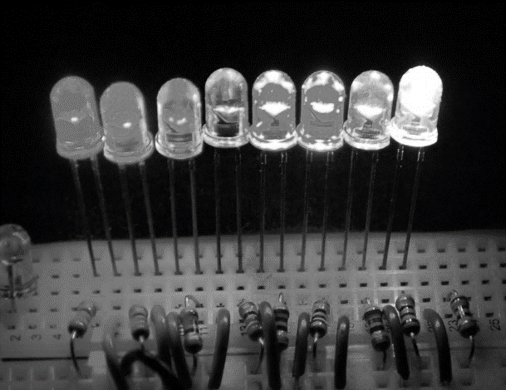
Introduction to Electronics EHB222E

Slide 2

Grading
Grading Method
Two Midterm Exams: 40%
Homework 5%
Quiz 5%
Final Exam: 50%
Attendence %50

Slide 3
Introduction to Electronics
Introduction
Semiconductors & Doping, Basics of pn junction
Diodes
BJT Transistors
MOSFET Transistors
Operational Amplifiers

Slide 4
What is Electricity?
Electricity is generated from the motion of tiny charged atomic particles called electrons and protons!
Protons = +
Electrons = -

Slide 5
What is Current?
When electrons flows through a conductor
We call this flow as “current.”
Only some materials have free electrons inside.
glass
rubber
oil
asphalt
fiberglass
porcelain
ceramic
quartz
(dry) cotton
(dry) paper
(dry) wood
plastic
air
diamond
pure water
YES!
NO!
silver
copper
gold
aluminium
iron
steel
brass
bronze
mercury
graphite
salty water
Conductors:
Insulators:
No free electrons = No current

Slide 6

How Does Current Flow?
Current can only flow through conductors
Metal wires (conductors)
+++
Current flow

Slide 7
When Does Current NOT Flow?
Current cannot flow through insulators
Plastic material (insulators)
+++
No current flow

Slide 8
Note that Air is an Insulator
Current cannot flow through insulators
+++
Air
No current flow
That’s why a battery doesn’t discharge if left on its own.

Slide 9
Current
Current is the amount of electric charge (coulombs) flowing past a specific point in a conductor over an interval of one second.
1 ampere = 1 coulomb/second
Electron flow is from a lower potential (voltage) to a higher potential (voltage).

Slide 10
Sign Convention for Current Flow
Electrons carry negative charge
Positive current flow is in opposite direction
-
-
-
-
-
-
-
-
-
-
-
-
-
-
-
-
-
-
-
-
-
-
-
-
electron motion
positive current direction

Slide 11
Current Flow
The direction of current flow is indicated by an arrow.
Voltage Source
+
_
Note: The voltage sources in the circuit flow current through nodes and wires.

Slide 12
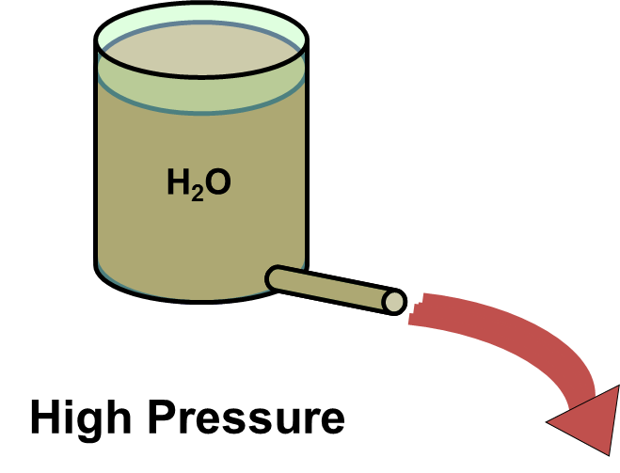
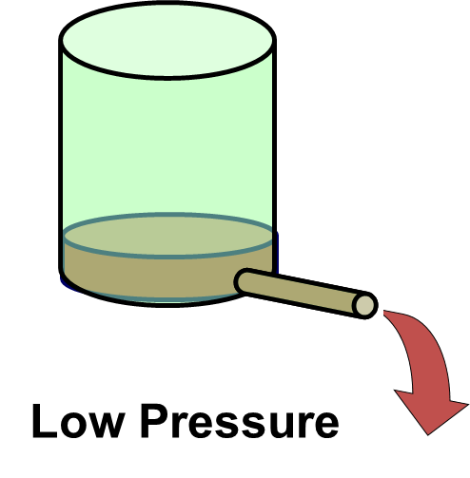
What is Voltage?
Voltage is the difference in energy level from one end of the battery (or any other energy source) to the other.
The energy difference causes the positive charges to move from a higher to to lover voltage in a closed circuit
V = “Electrical pressure”
- measured in volts.

Slide 13
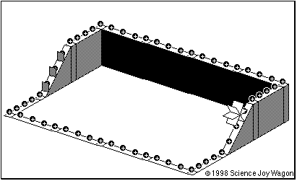
A battery in an electrical circuit plays the same role as a pump in a water system.
A battery establishes a difference of potential that can pump electrons.
A battery pushes the electrons through the conductor.

Slide 14
Electric Circuit
Two or more nodes connected just by wires can be considered as one single node.
Nodes are Connected
by Wires Only
A single node
One big node
Electronic elements
Conducting wires
Group of nodes connected only by wires
One big node

Slide 15
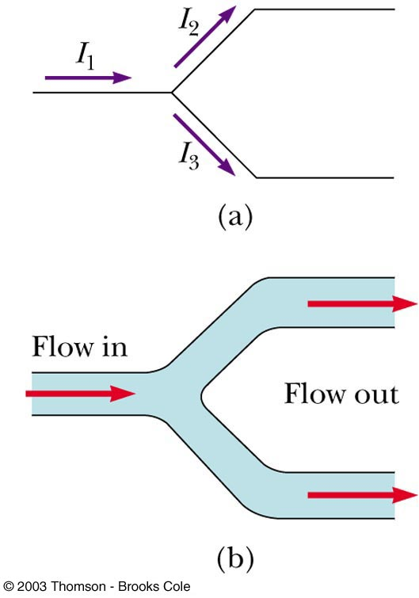
From Conservation of Charge
I₁ = I₂ + I₃
Diagram b shows a mechanical analogy

Slide 16
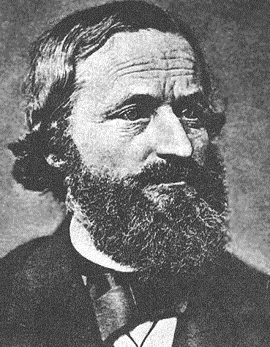
Kirchhoff’s Current Law
The sum of currents flowing into a node must be balanced by the sum of currents flowing out of the node.
i₁
node
i₂
i₃
Gustav Kirchoff was an 18th century German mathematician
i₁ flows into the node
i₂ flows out of the node
i₃ flows out of the node
i₁ = i₂ + i₃

Slide 17
Kirchhoff’s Current Law: i₁ = i₂ + i₃
This equation can also be written in the following form:
i₁ – i₂ – i₃ = 0
i₁
node
i₂
i₃
A formal statement of Kirchhoff’s Current Law:
The sum of all the currents entering a node is zero.
(i₂ and i₃ leave the node, hence currents –i₂ and –i₃ enter the node.)

Slide 18
Example 1: Kirchhoff’s Current Law:
Q: How much is the current I_{o} ?
A: i_{o} = 2.5 mA + 4 mA = 6.5 mA
2.5 mA
4 mA
i_{o}
i₄
i₂
i₃
Note that a “node” need not be a discrete point
The dotted circle is a node with 2.5 mA entering
Hence i₂ = 2.5 mA exits the “node”.
Similarly, i₃ = 4 mA.
From KCL, i₄ = i₂ + i₃ = 6.5 mA, and I_{o} = i₄

Slide 19
Example 2: Kirchhoff’s Current Law:
Q: How much are the currents i₁ and i₂ ?
A: i₂ = 10 mA – 3 mA = 7 mA
i₁ = 10 mA + 4 mA = 14 mA
10 mA
node
i₁
3 mA
i₂
4 mA
+
_
4 mA + 3 mA + 7 mA = 14 mA

Slide 20
Sometimes Kirchhoff’s Current Law is abbreviated just by
KCL
Review: Different ways to state KCL:
The sum of all currents entering a node must be zero.
The net current entering a node must be zero.
Whatever flows into a node must come out.
more to follow…

Slide 21
Voltage (Difference in energy level )
Voltages are measured across the nodes of a circuit.
The direction of a voltage is indicated by + and – signs.
+ v₂ –
+
v₁
–
+
v₃
–
+
v₄
–
+
_
Remember: The voltage sources in a circuit flow
current through the conductors.

Slide 22
Kirchhoff’s Voltage Law
The voltage measured between any two nodes does not depend of the path taken.
voltage
+ v₂ –
voltage
+
v₁
–
+
v₃
–
+
v₄
–
+
voltage
_
Example of KVL:
v₁= v₂ + v₃
Similarly:
v₁= v₂ + v₄
and:
v₃= v₄

Slide 23
Kirchhoff’s Voltage Law: v₁ = v₂ + v₃
This equation can also be written in the following form:
–v₁ + v₂ + v₃ = 0
+ v₂ –
+
v₁
–
+
v₃
–
+
v₄
–
+
_
A formal statement of Kirchhoff’s Voltage Law:
The sum of voltages around a closed loop is zero.

Slide 24
Using the Formal Definition of KVL
“The sum of voltages around a closed loop is zero.”
Define an arrow direction around a closed loop.
Sum the voltages that are encountered around the loop.
If the arrow first encounters a plus sign, enter that voltage with a (+) into the KVL equation.
If the arrow first encounters a minus sign, enter that voltage with a (–) into the KVL equation.
+ v₂ –
+
v₁
–
+
v₃
–
+
v₄
–
+
_
For the inner loop :
–v₁ + v₂ + v₃ = 0
For the outer loop:
–v₄ – v₂ + v₁ = 0

Slide 25
Example 1: Kirchhoff’s Voltage Law:
Q: How much is the voltage V_{o} ?
A: V_{o} = 3.1 V + 6.8 V
+ 3.1V –
+
6.8 V
–
+
v₄
_
+
_
V_{o}
Q: How much is the voltage v₄ ?
A: v₄ = 6.8 V

Slide 26
Example 2: Kirchhoff’s Voltage Law:
Q: If v₁ = 10 V and v₅ = 2 V, what are v₂, v₃, and v₄?
A: -v₁ + v₂ = 0 ⇒ v₂ = 10 V
-v₂ + v₃ + v₅ = 0 ⇒ v₃ = 10 V – 2 V = 8 V
-v₄ + v₅ = 0 ⇒ v₄ = 2 V
+ v₃ –
+
v₂
–
+
v₄
–
+
v₅= 2 V
–
+
v₁ = 10 V
–
+
_

Slide 27
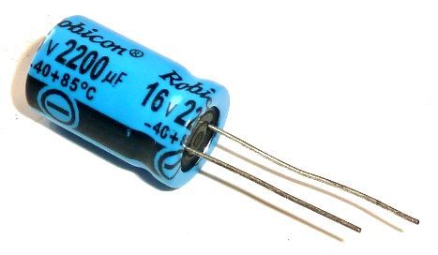
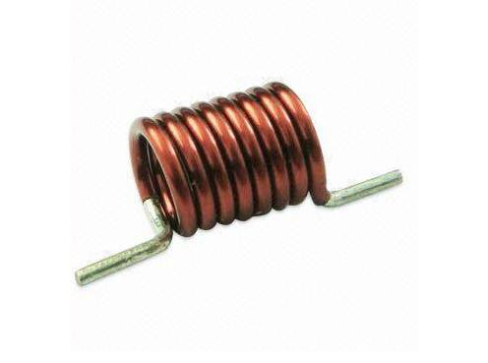
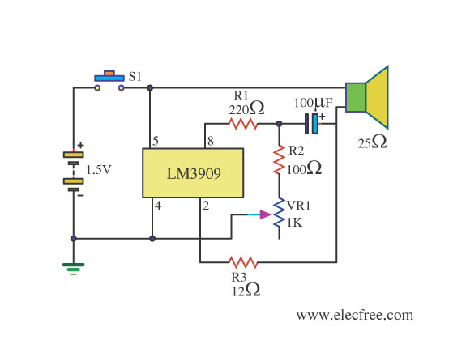

Electronic Circuits
Circuits are obtained by connecting electronic elements
Typical electronic elements are
diodes
resistors,
capacitors,
inductors

Slide 28
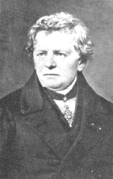
Ohm’s Law & Resistors
Let us remind the Ohm’s Law
V
I = ——
R
Georg Ohm
V
+
_
V
R = ——
I
Assume that the wires are “perfect conductors”
The unknown circuit element limits the flow of current.
The resistive element has resistance R

Slide 29
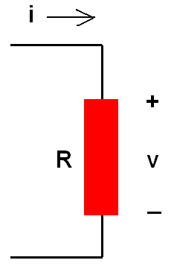
Ohm’s Law
Voltage drop across a resistor is proportional to the current flowing through the resistor
If the resistor is a perfect conductor (or a short circuit)
R = 0 ohm, then
v = iR = 0 V
no matter how much current is flowing through the resistor

Slide 30
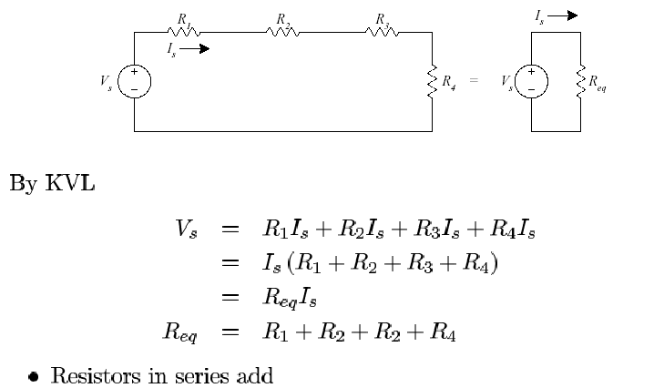
Resistors in Series

Slide 31
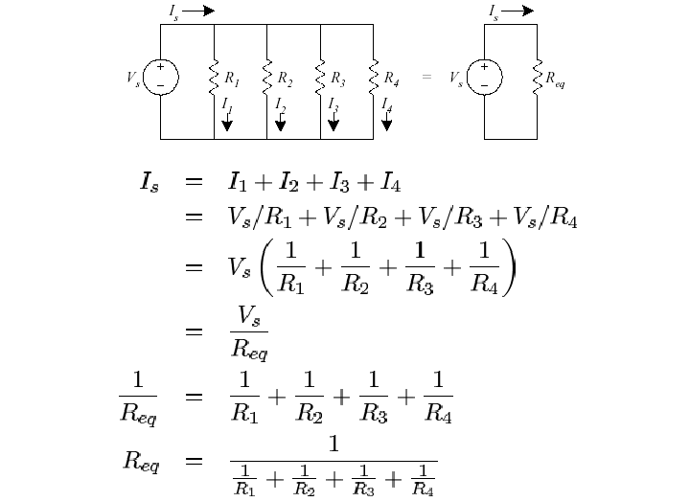
Resistors in Parallel

Slide 32
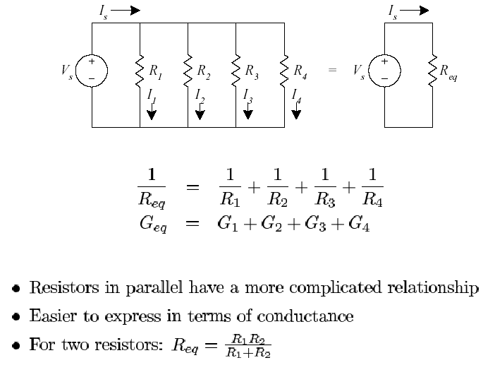
Resistors in Parallel

Slide 33
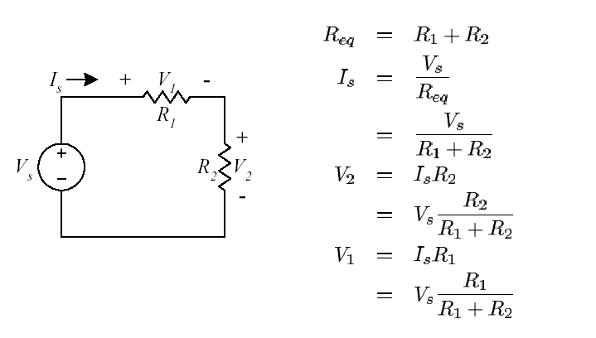
Voltage Divider

Slide 34
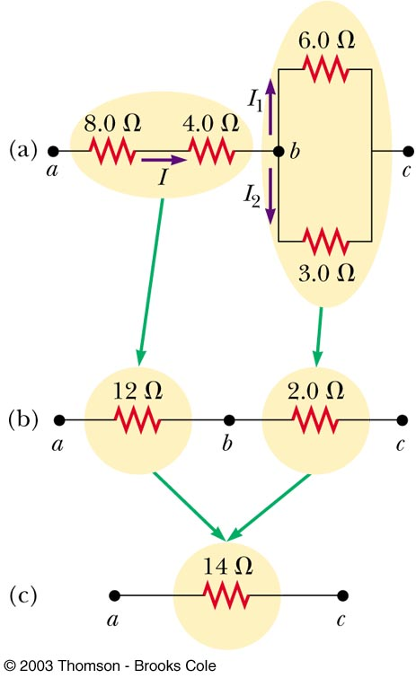
Equivalent Resistance – Complex Circuit

Slide 35
Maximum Charge on a Conductor
A battery establishes a difference of potential that can pump electrons e⁻ from a ground (earth) to a conductor
Battery
Conductor
-
-
-
-
-
Earth
-
-
e⁻
e⁻
-
-
-
-
-
-
-
There is a limit to the amount of charge that a conductor can hold without leaking to the air. There is a certain capacity for holding charge.

Slide 36
Capacitance
The capacitance C of a conductor is defined as the ratio of the charge Q on the conductor to the potential V produced.
Battery
Conductor
-
-
-
-
-
Earth
-
-
e⁻
e⁻
-
Q, V
-
-
-
-
-
-
Capacitance:

Slide 37
The Capacitor
Capacitors are one of the fundamental passive components. In its most basic form, it is composed of two plates separated by a dielectric.
The ability to store charge is the definition of capacitance.
Conductors
Dielectric

Slide 38
The Capacitor
The charging process…
Initially uncharged
Source removed
Fully charged
Charging
A capacitor with stored charge can act as a temporary battery.

Slide 39
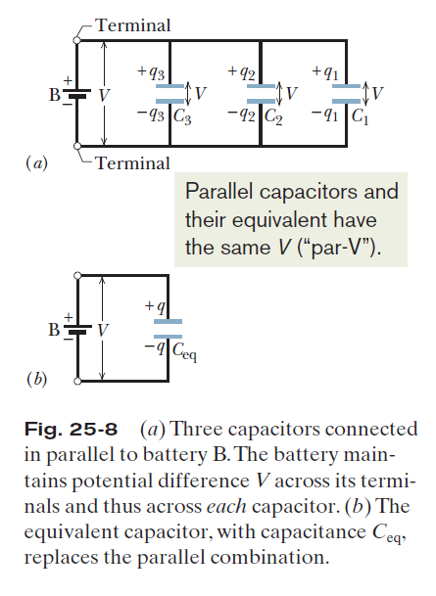
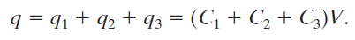
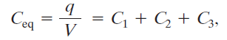
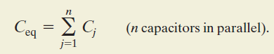
Capacitors in Parallel:

Slide 40
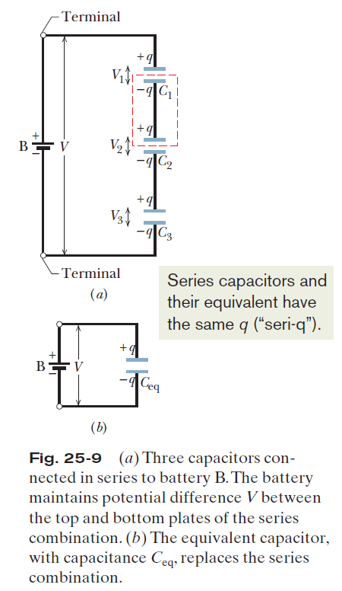
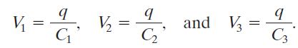
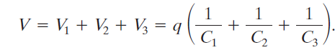
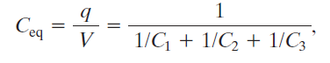
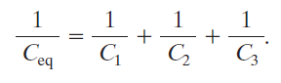
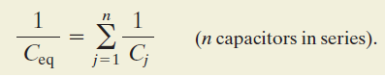
Capacitors in Series:

Slide 41
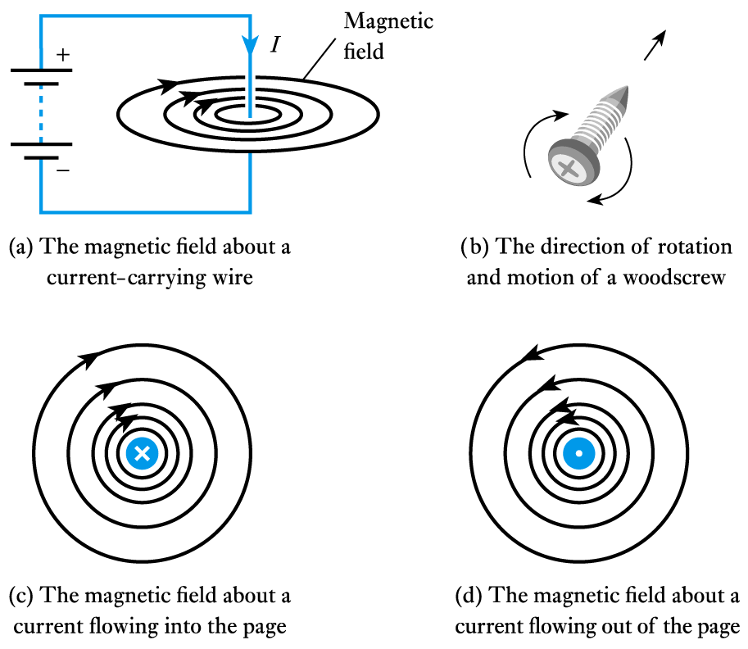
Electromagnetism
A wire carrying a current I produces a magnetic field

Slide 42
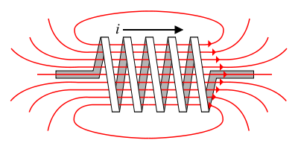
Inductance
Energy Storage Devices
Stores energy in an magnetic field created by the electric current flowing through it.
The flow of current through an inductor creates a magnetic field
If the current flowing through the inductor drops, the magnetic field will also decrease and energy is released through the generation of a current.
B field

Slide 43
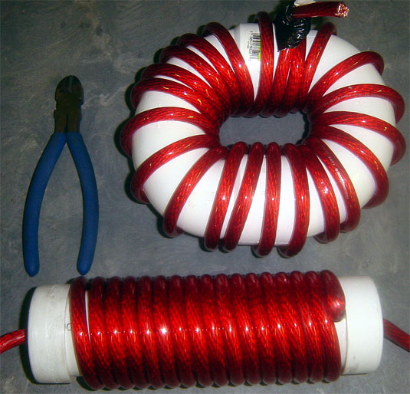
Inductors
Generally - coil of conducting wire
Usually wrapped around a solid core. If no core is used, then the inductor is said to have an ‘air core’.

Slide 44
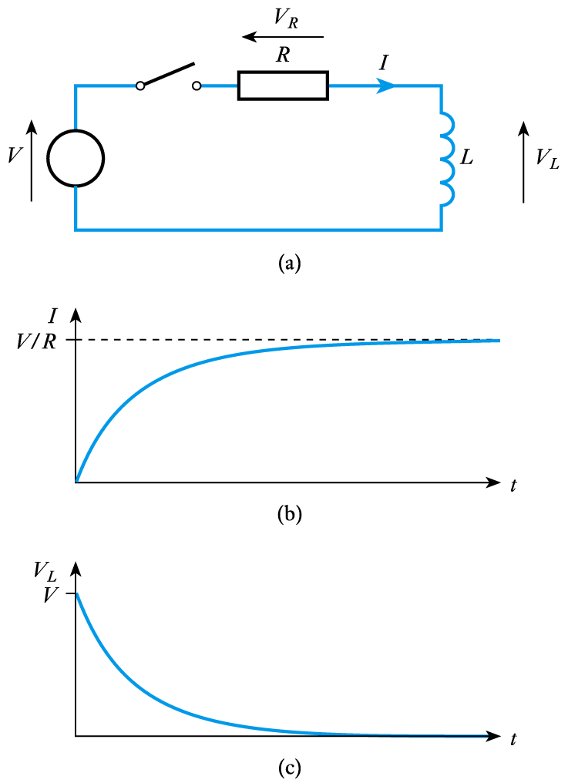
Voltage and Current Relation
Consider the circuit shown here
inductor is initially un-energised
current through it will be zero
switch is closed at t = 0
I is initially zero
hence V_{R} is initially 0
hence V_{L} is initially V
as the inductor is energised:
I increases
V_{R} increases
hence V_{L} decreases
we have exponential behaviour

Slide 45
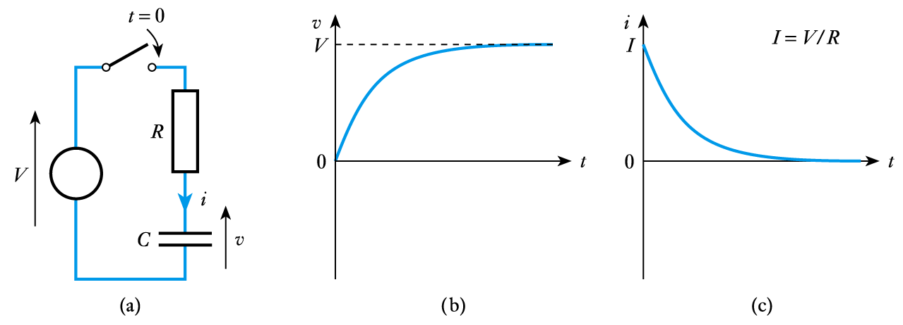
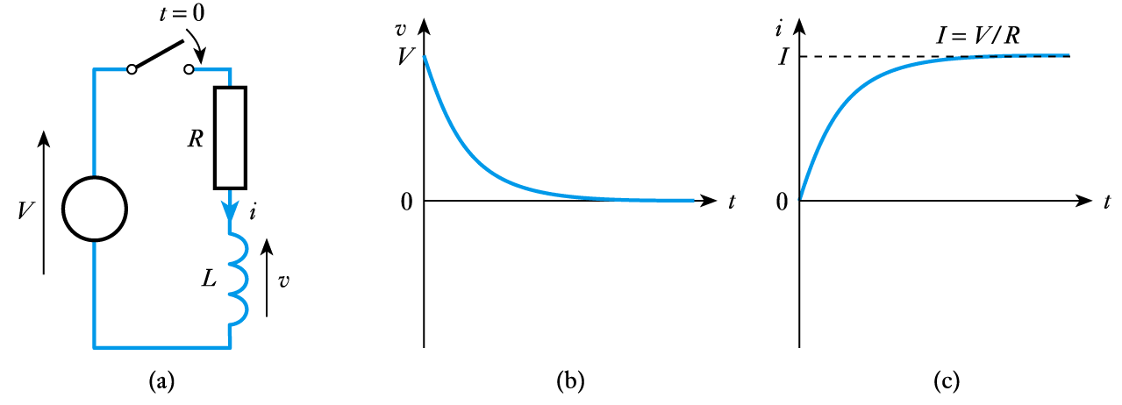
Both the voltage and current have an exponential forms
C , capacitance, has the units of Farad (F)
1 F = 1 A.sn/V
L , inductance, has the units of Henries (H)
1 H = 1 V.sn/A

Slide 46
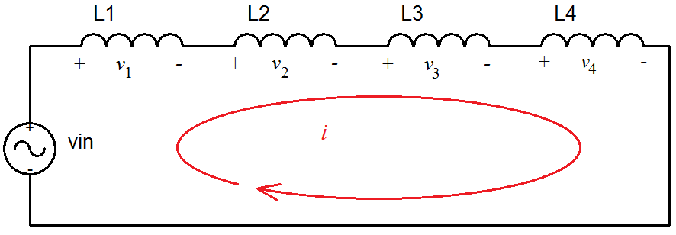
Inductors in Series

Slide 47
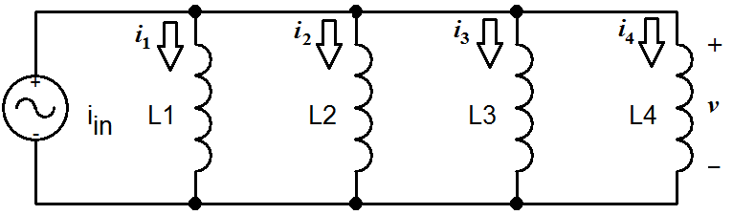
Inductors in Parallel

Slide 48
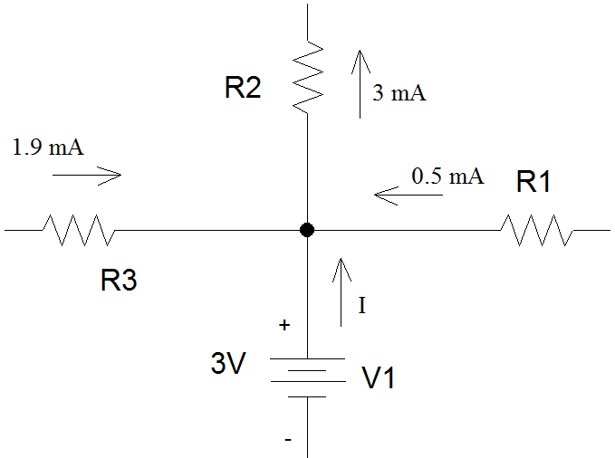
Example 1
Determine I, the current flowing out of the voltage source.
Use KCL
1.9 mA + 0.5 mA + I are
entering the node.
3 mA is leaving the node.
V1 is generating power.

Slide 49
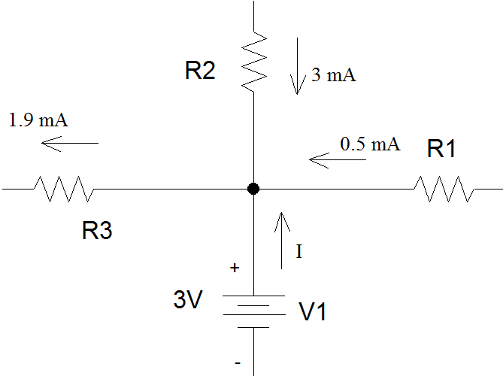
Example 2
Suppose the current through R2 was entering the node and the current through R3 was leaving the node.
Use KCL
3 mA + 0.5 mA + I are
entering the node.
1.9 mA is leaving the node.
V1 is dissipating power.

Slide 50
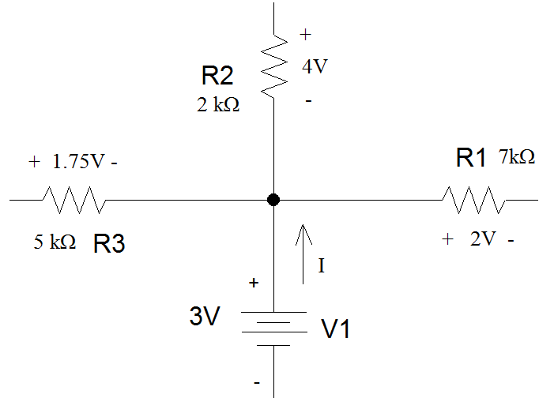
Example 3
If voltage drops are given instead of currents, you need to apply Ohm’s Law to determine the current flowing through each of the resistors before you can find the current flowing out of the voltage supply.

Slide 51
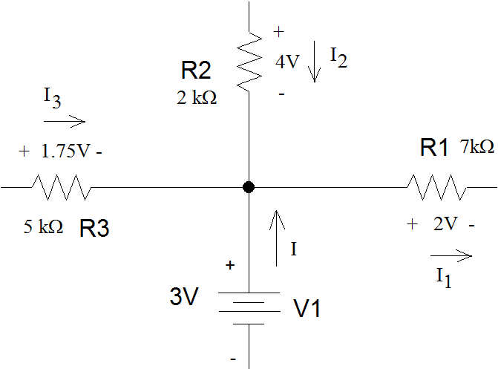
Example 3 (con’t)
For power dissipating components such as resistors, passive sign convention means that current flows into the resistor at the terminal has the + sign on the voltage drop and leaves out the terminal that has the – sign.

Slide 52
Example 3 (con’t)

Slide 53
Example 3 (con’t)
I1 is leaving the node.
I2 is entering the node.
I3 is entering the node.
I is entering the node.

Slide 54
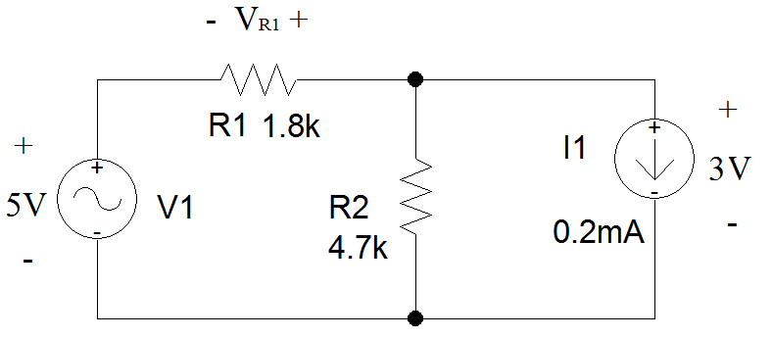
Example 4
Find the voltage across R1. Note that the polarity of the voltage has been assigned in the circuit schematic.
First, define a loop that include R1.

Slide 55
Example 4 (con’t)
There are three possible loops in this circuit – only two include R1.
Either loop may be used to determine V_{R1}.

Slide 56
Example 4 (con’t)
If the outer loop is used:
Follow the loop clockwise.

Slide 57
Example 4 (con’t)
Follow the loop in a clockwise direction.
The 5V drop across V1 is a voltage rise.
V_{R1} should be treated as a voltage rise.
The loop enters on the positive side of the CURRENT source and exits out the negative side. This is a voltage drop as the voltage becomes less positive as you move through the component.

Slide 58
Example 4 (con’t)
By convention, voltage drops are added and voltage rises are subtracted in KVL.

Slide 59
Example 4 (con’t)
Suppose you chose the green loop instead.
Since R2 is in parallel with I1, the voltage drop across R2 is also 3V.

Slide 60
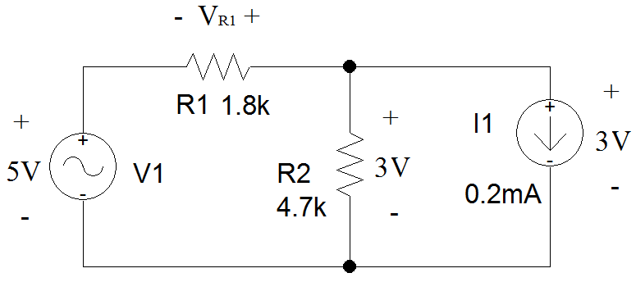
Example 4 (con’t)
The 5V drop across V1 is a voltage rise.
V_{R1} should be treated as a voltage rise.
The loop enters R2 on the positive side and exits out the negative side. This is a voltage drop as the voltage becomes less positive as you move through the component.

Slide 61

Example 4 (con’t)
As should happen, the answer is the same.

Slide 62
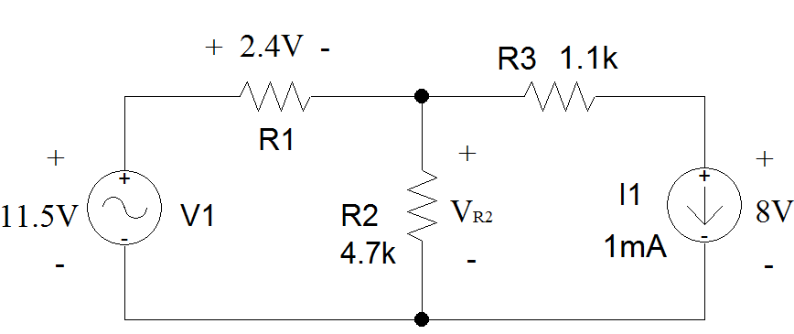
Example 5
Find the voltage across R2 and the current flowing through it.
First, draw a loop that includes R2.

Slide 63
Example 5 (con’t)
There are two loops that include R2.
The one on the left can be used to solve for V_{R2} immediately.

Slide 64
Example 5 (con’t)
Following the loop in a clockwise direction.
The 11.5V drop associated with V1 is a voltage rise.
The 2.4V associated with R1 is a voltage drop.
V_{R2} is treated as a voltage drop.

Slide 65
Example 5 (con’t)

Slide 66
Example 5 (con’t)
If you used the right-hand loop, the voltage drop across R3 must be calculated using Ohm’s Law.

Slide 67
Example 5 (con’t)
Since R3 is a resistor, passive convention means that the positive sign of the voltage drop will be assigned to the end of R3 where current enters the resistor.
As I1 is in series with R3, the direction of current through R3 is determined by the direction of current flowing out of the current source.
Because I1 and R3 are in series, the magnitude of the current flowing out of I1 must be equal to the magnitude of the current flowing out of R3.

Slide 68
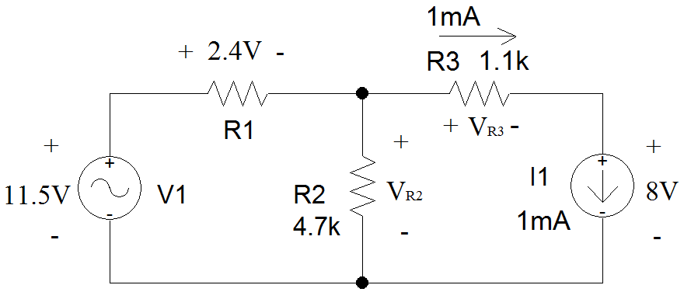
Example 5 (con’t)
Use Ohm’s Law to find V_{R3}.

Slide 69
Example 5 (con’t)
Moving clockwise around the loop:
V_{R3} is a voltage drop.
The voltage associated with I1 is a voltage drop.
V_{R2} is a voltage rise.

Slide 70
Example 5 (con’t)
Again, the same answer is found.

Slide 71
Example 5 (con’t)
Once the voltage across R2 is known, Ohm’s Law is applied to determine the current.
The direction of positive current flow, based upon passive sign convention is shown in red.
I_{R2}

Slide 72
Example 5 (con’t)
I_{R2}

